Slide 1
Lecture 1 Introduction
CE346 – Microprocessor System Design
Branden Ghena – Spring 2021
Some slides borrowed from: Josiah Hester (Northwestern), Prabal Dutta (UC Berkeley)

Slide 2
Welcome to CE346!
Focus on hardware/software systems and their design
Hardware/Software co-design
How do you write software that interacts with hardware?
How do you choose hardware to support software needs?
Sensors and Sensing
What can sensors do and how do they work?
How do you write applications that sense the world?

Slide 3
Today’s Goals
What are the goals of this course?
Why do I think embedded systems are so important?
How is the course going to operate?

Slide 4
Outline
Who and Why
Embedded Systems
Course Overview

Slide 5
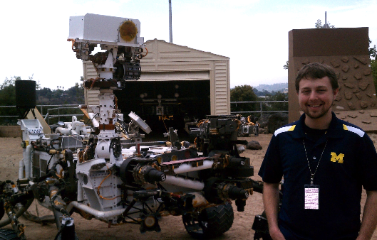
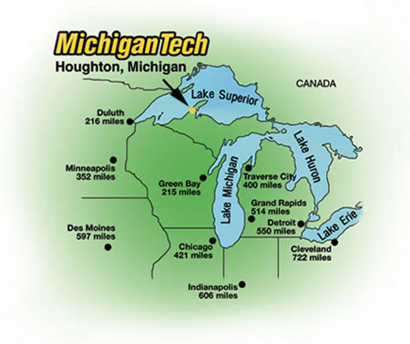
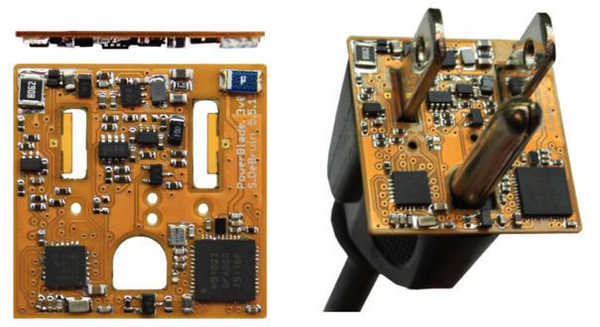
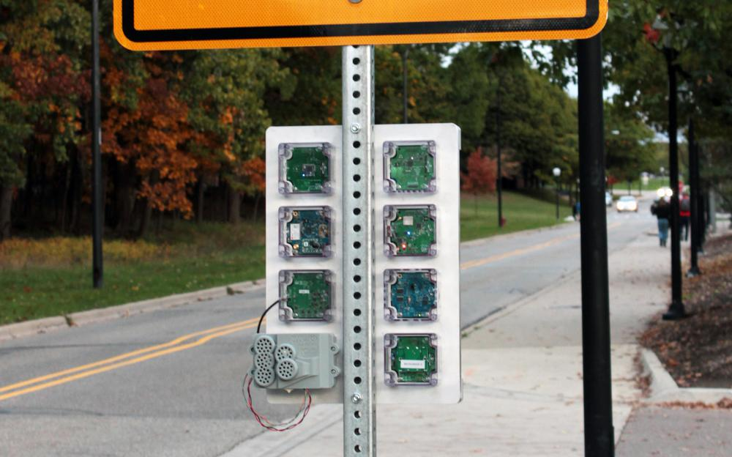



Branden Ghena (he/him)
Assistant Faculty of Instruction
Education
Undergrad: Michigan Tech
Master’s: University of Michigan
PhD: University of California, Berkeley
Research
Resource-constrained sensing systems
Low-energy wireless networks
Embedded operating systems
Teaching
Computer Systems
Intro to Computer Systems
Operating Systems
Wireless Protocols for the IoT
Things I love

Slide 6

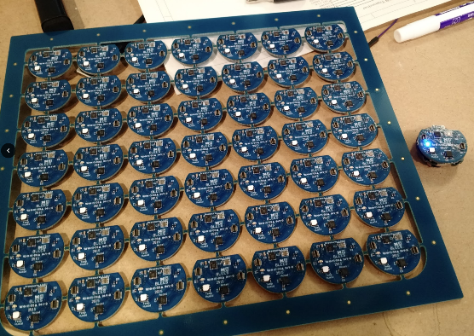
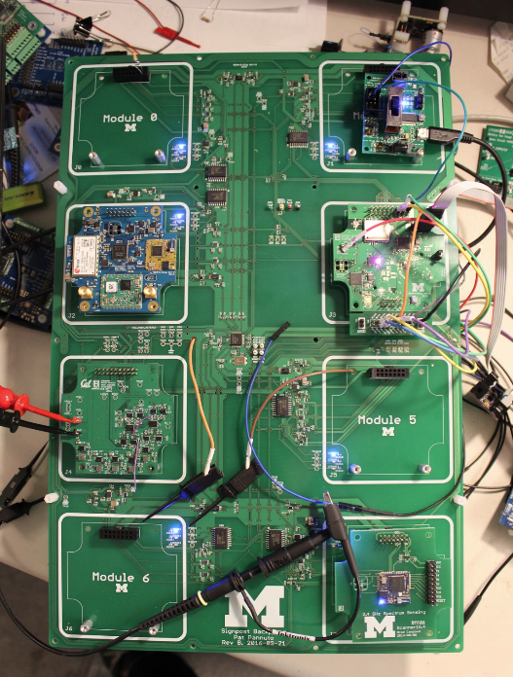
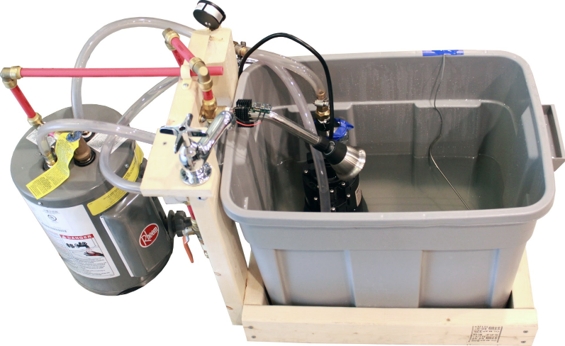
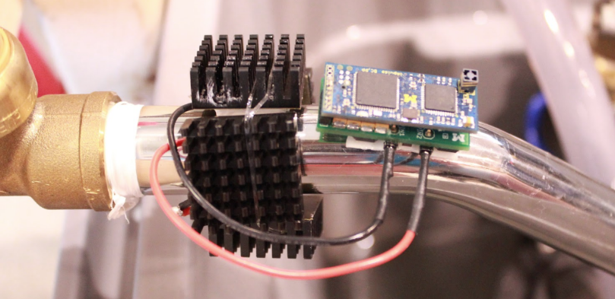
Research area: resource-constrained embedded systems
Most interesting to me: the interfaces
Hardware and software
Applications and OS
Communication

Slide 7
Faculty: now I can choose what to teach!
Goal: provide classes that teach more advanced embedded systems topics
Hopefully, generally useful to other nearby domains of CS and ECE too!
An immediate result: this course!
Really would be much nicer in person, but 🤷‍♀️
Course goal: introduce students to hardware-software interactions
Practical hands-on experience with microcontrollers and sensors
Open-ended project where students can choose their specific focus

Slide 8
Outline
Who and Why
Embedded Systems
Course Overview

Slide 9
What is an embedded system?
A computer built into a device such that the device is interacted with, not the computer
Not a desktop, laptop, server, smartphone, smartwatch
(although many of those deal with overlapping hardware/software issues)
Many domains
Robotics
Industrial processes
Smart home
Smart city
Wearables and health sensing
Generally: Internet of Things

Slide 10
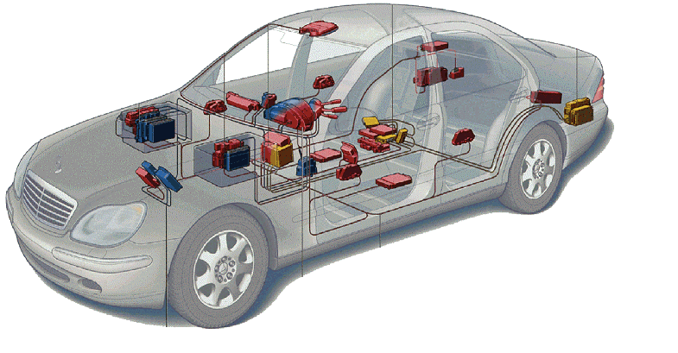
Related area: Cyber-Physical Systems
Systems that are part computational and part real-world
Example: autonomous vehicles
Combines multiple fields to handle this problem
Embedded Systems
Electronics
Controls
Software Engineering
Computer Theory
Automotive

Slide 11
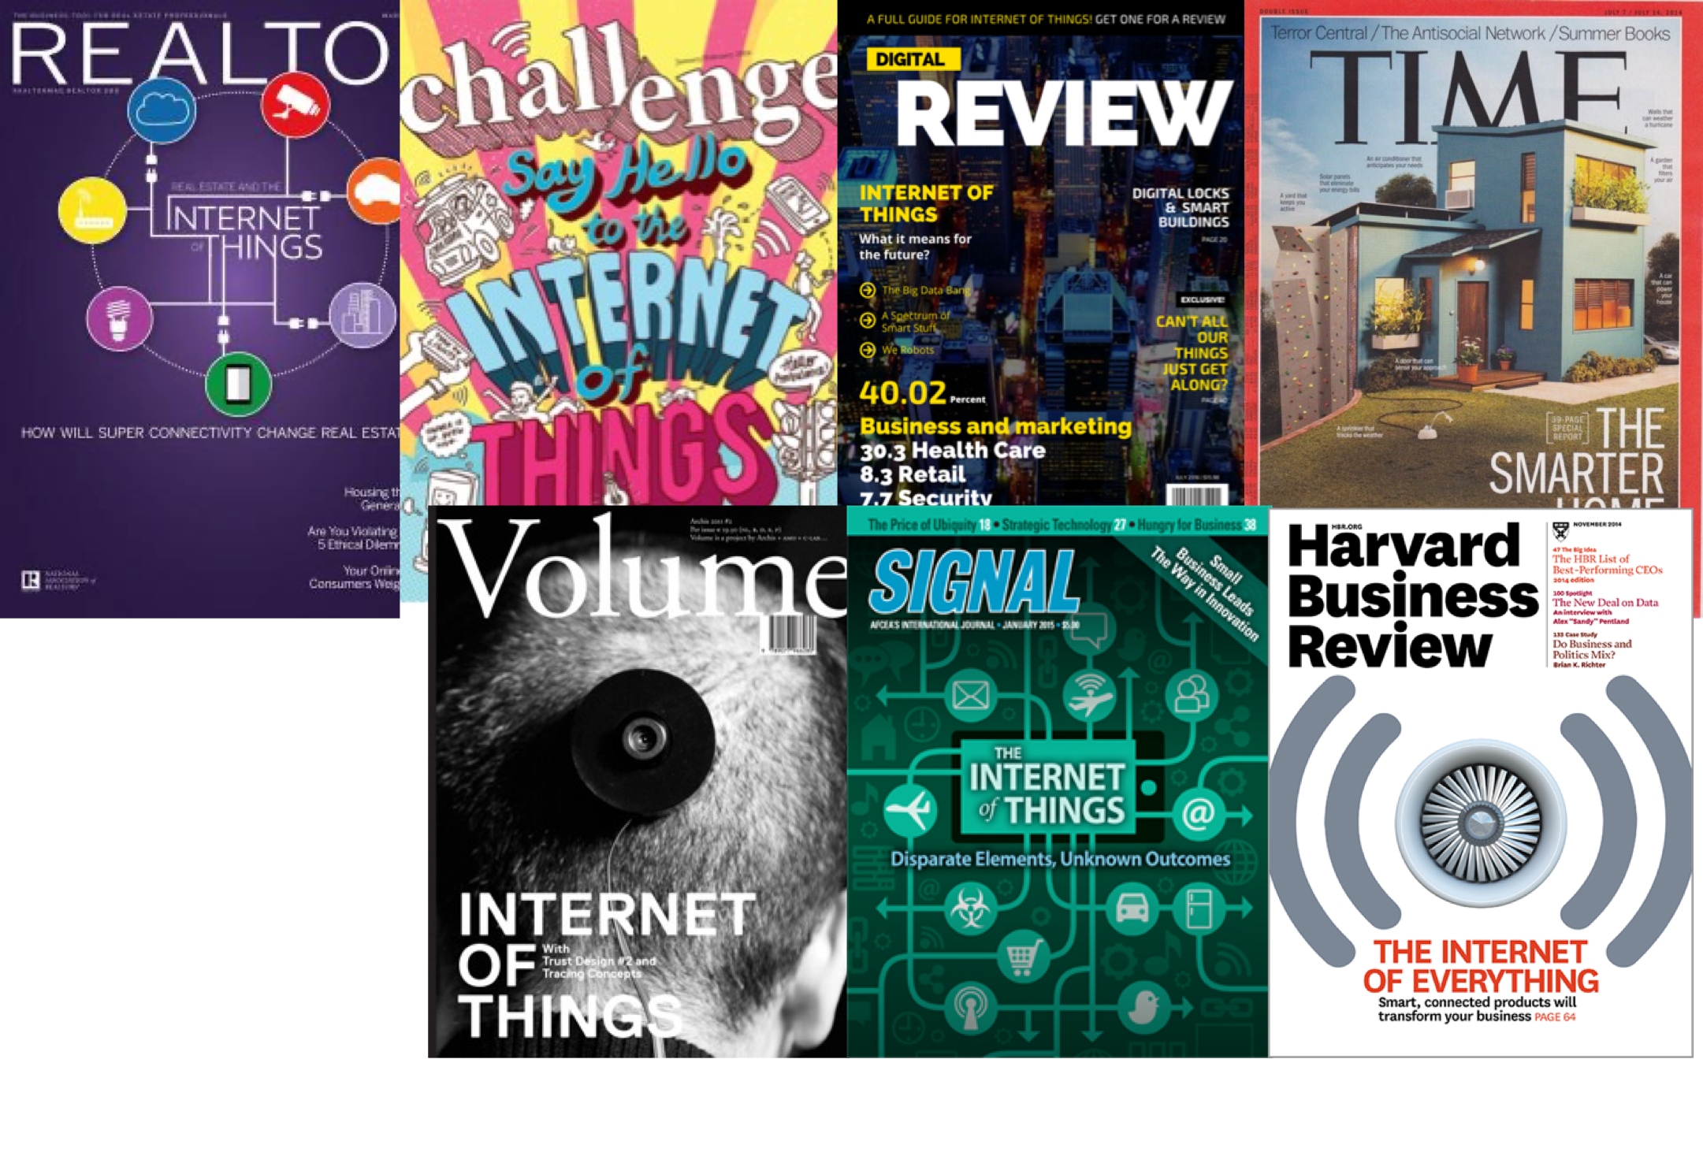
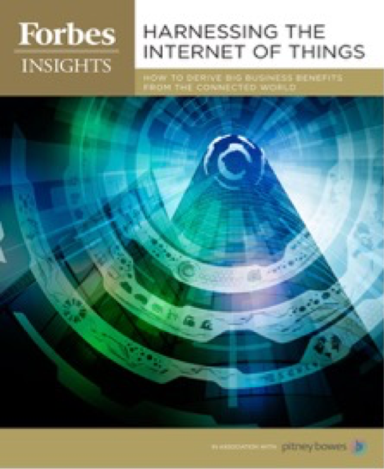
The Internet of Things

Slide 12
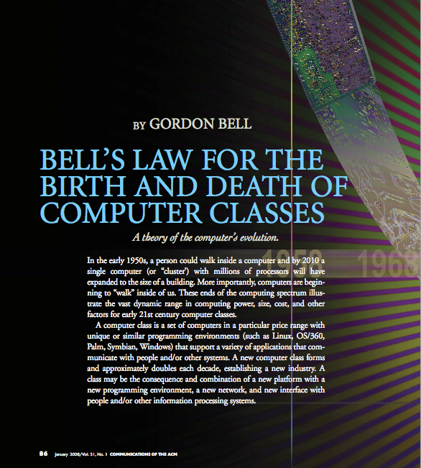
Bell’s Law: A new computer class every decade
“Roughly every decade a new, lower priced computer class forms based on a new programming platform, network, and interface resulting in new usage and the establishment of a new industry.”
- Gordon Bell [1972,2008]

Slide 13
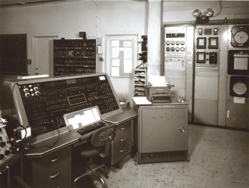
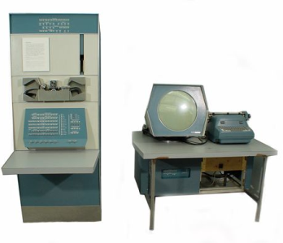
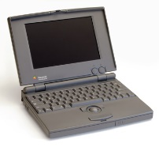
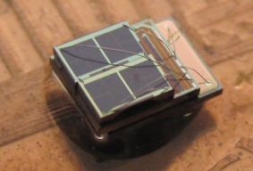

Number of computers per person grows over time
Mainframe
1 per Enterprise
[Bell et al. Computer, 1972, ACM, 2008]
Workstation
1 per Engineer
Laptop
1 per Professional
log (people per computer)
Smart Sensors
Mini Computer
Ubiquitous
1 per Company
Personal Computer
100 – 1000’s per person
1 per Family
1 per person
Smartphone

Slide 14
Computer volume shrinks by 100x every decade
Mainframe
1 per Enterprise
100x smaller every decade
Workstation
1 per Engineer
[Nakagawa08]
Laptop
1 per Professional
Smart Sensors
Mini Computer
Ubiquitous
1 per Company
Personal Computer
100 – 1000’s per person
1 per Family
1 per person
Smartphone

Slide 15
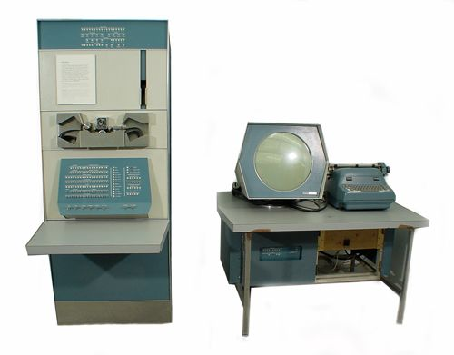
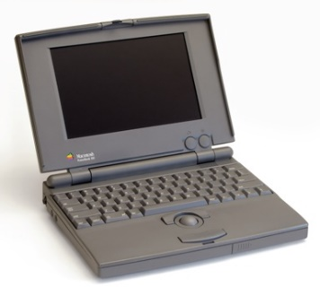
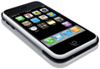

Price falls dramatically, enabling new applications
Mainframe
Workstation
Number Crunching
Data Storage
Laptop
productivity
interactive
Mini Computer
streaming
information
to/from the
physical
world
Smart Sensors
Personal Computer
Smartphone

Slide 16
Discussion: what is the Internet of Things?
Name a few Internet of Things devices
What are the qualities that designate those devices at “IoT”?

Slide 17
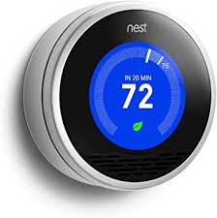
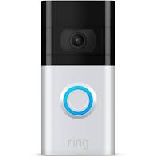
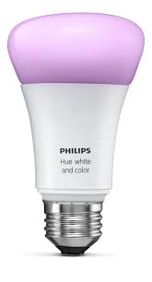
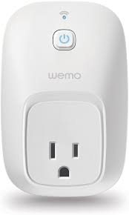
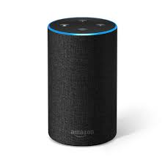
Discussion: what is the Internet of Things?
Name a few Internet of Things devices
What are the qualities that designate those devices at “IoT”?

Slide 18
Thought experiment on capabilities
What if the Nest thermostat was powered by an entire desktop?
8-core x86-64 processor, 32 GB RAM, 1 TB SSD
Would that still count as IoT?
Could that still be an embedded system?
Why don’t we see that in practice?

Slide 19
Thought experiment on capabilities
What if the Nest thermostat was powered by an entire desktop?
8-core x86-64 processor, 32 GB RAM, 1 TB SSD
Would that still count as IoT?
Doesn’t really feel right. Built in assumption of limitations.
Could that still be an embedded system?
Yes
Why don’t we see that in practice?
Cost

Slide 20
Thought experiment on energy
IoT devices include a mix of batteries, wall power, (and energy-harvesting)
Why do we put so much focus on systems with batteries?
Why do they need batteries?

Slide 21
Thought experiment on energy
IoT devices include a mix of batteries, wall power, (and energy-harvesting)
Why do we put so much focus on systems with batteries?
Why do they need batteries?
Deployability

Slide 22
Branden’s take on the Internet of Things
Key features
Computation
Local to the device
With some capability for arbitrary compute and storage
Connectivity
Almost certainly wireless
Likely Internet, possibly local
Interaction
Sensing or Actuation
Secondary features
Low energy
(Relatively) Low cost

Slide 23
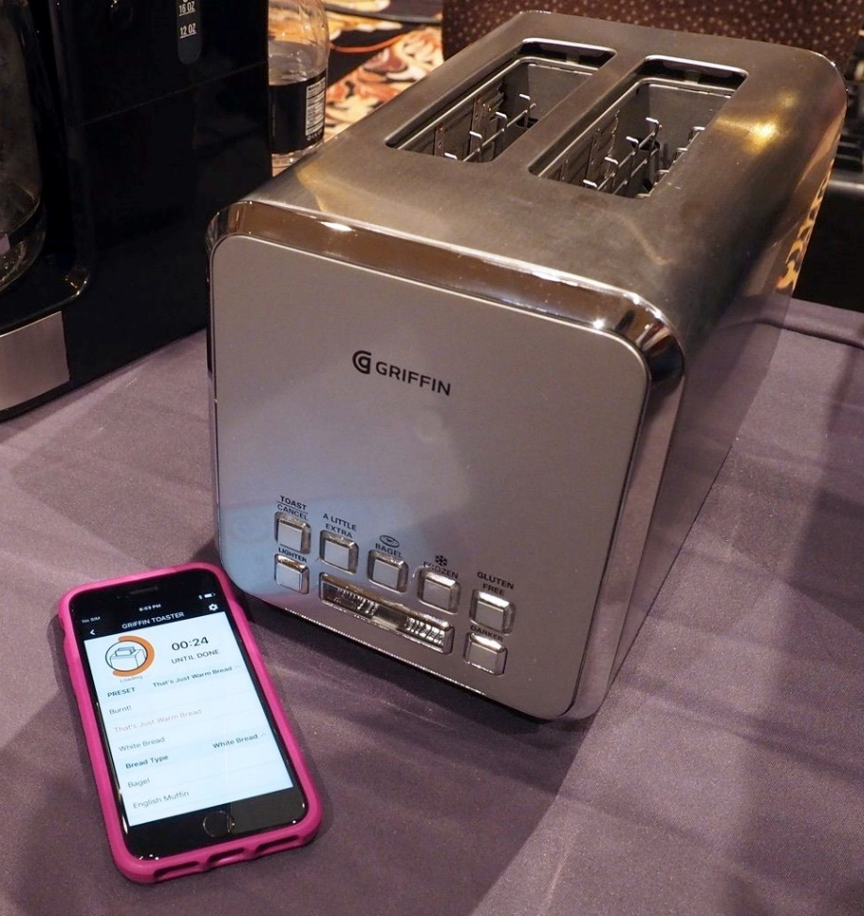
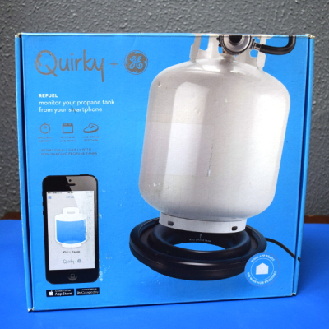
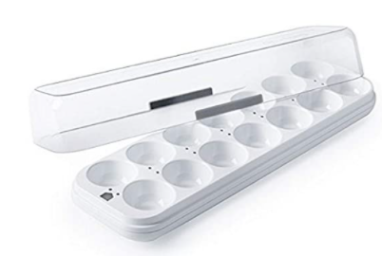
Warning: Internet of Crap

Slide 24
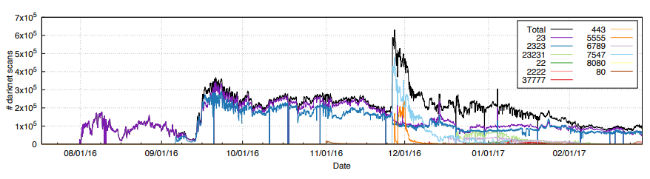
Internet of Insecure Crap
Mirai botnet (2016)
Takes control of up to 600,000 insecure connected devices
IP-attached cameras, DVRs, routers, printers
Used to DoS websites

Slide 25
What makes resource-constrained embedded systems interesting?
Focus on the real world
You can actually see the purpose and effects of your applications
Easily explainable to non-engineer humans
Challenging limitations
Limited memory and processing
Energy concerns

Slide 26
What makes resource-constrained embedded systems frustrating?
Challenging limitations
Limited memory and processing
Energy concerns
Full-stack development means problems could be anywhere
Hardware problems
Firmware problems
Software problems

Slide 27
Outline
Who and Why
Embedded Systems
Course Overview

Slide 28
Course Time
M/W/F 10:00-10:50am (not using the Tuesday slot)
This week: Lecture on Tuesday, Wednesday, and Friday
Starting next week:
Lecture: Monday and Wednesday
Lab: Friday
Attempt to recreate lab environment over zoom
Breakout groups to encourage chatting and asking questions

Slide 29
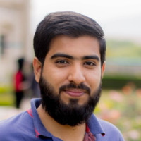
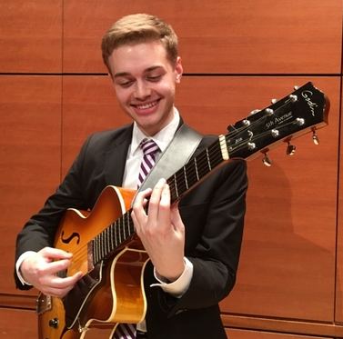
Course Staff and Office Hours (starting next week)
Abu Bakar
Office hours
Tuesday 11:00–1:00pm
Thursday 9:00–11:00am
Julian Richey
Office hours
Tuesday 3:00–5:00pm
Thursday 3:00–5:00pm
My office hours: (starting this week)
Monday 11:00-12:00 pm
Wednesday 1:00-2:00 pm
Or by request!

Slide 30
Course Communication
Campuswire
You should all already be registered on it
If you aren’t, let me know! (or if you want to change emails)
All course communication goes through Campuswire, not email
Multiple people can respond to you
Messages are kept in one place and stay “unanswered”
You can post directly to “Instructors & TAs” if it is private

Slide 31
Course grade components
45% Labs
6 labs at 7% each, plus 3% for “Getting Started Lab”
Guided exploration of course concepts
30% Quizzes
4 timed quizzes at 7.5% each
Covers lecture material from last two weeks
25% Final Project
Proposal due 2/3s of the way through class
Use knowledge from lab to create your own project

Slide 32
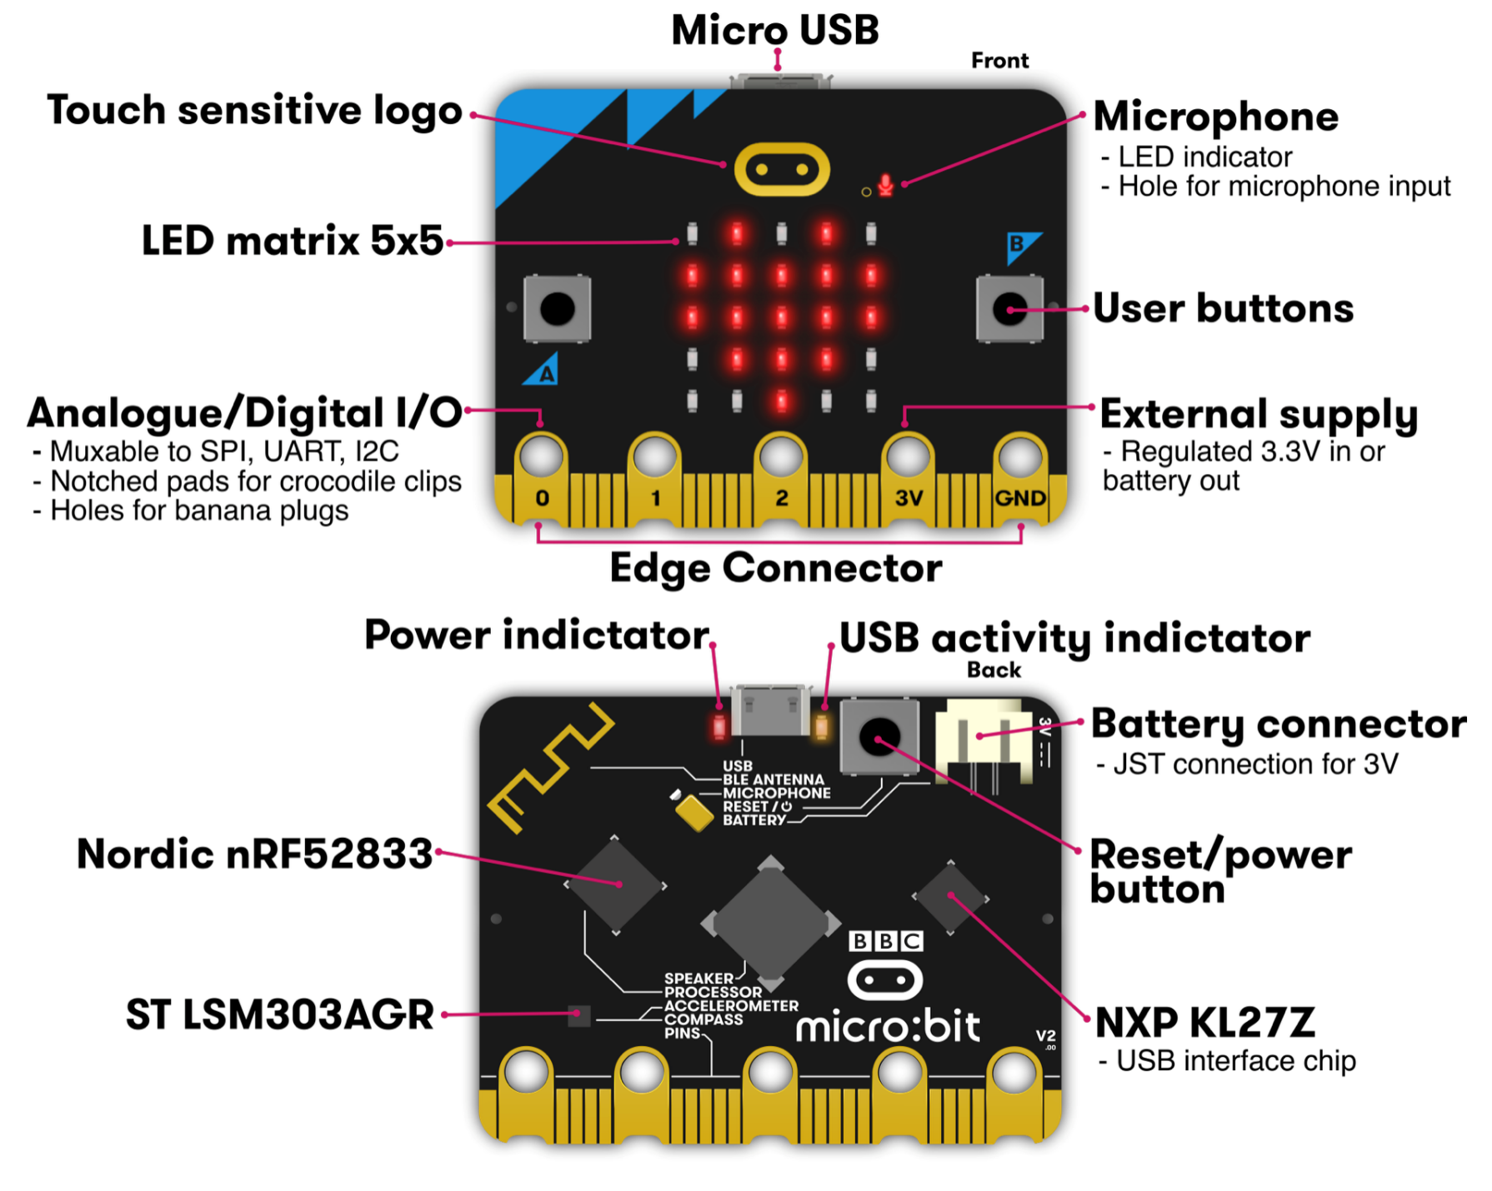
Micro:bit v2
Legacy from 1980s “BBC Computer Literacy Project”
Under $20
Modern microcontroller AND sensors
Plan for class:
Explore most of its functionality

Slide 33
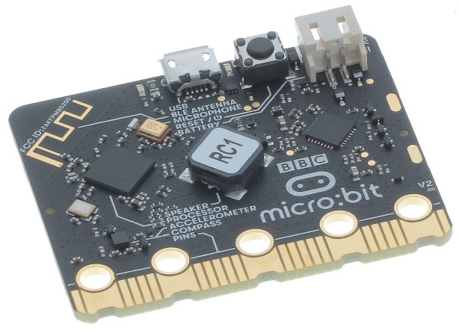
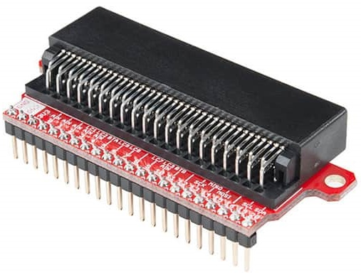
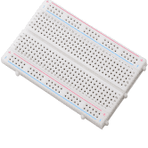
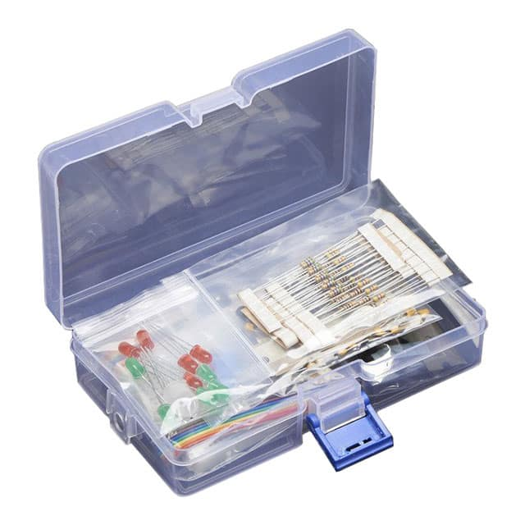
Lab kit
Everyone gets
Microbit
Microbit-to-breadboard interface
Breadboard
Various components
USB micro cable
Fill out survey from Campuswire ASAP!!!
I need your addresses to send you stuff
I can wait a few days if you’re not sure if you’re staying in the course
Let me know if you’re international, and we’ll figure it out

Slide 34
Labs
0. Getting Started (later this week)
MMIO and Interrupts
Virtual Timers
LED Matrix
Breadboarding
Audio Input/Output
I2C Accelerometer/Magnetometer
Labs will be individual work
Due end-of-day the next Friday (a week plus 14 hours after assigned)

Slide 35
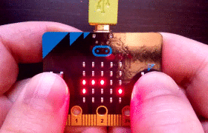
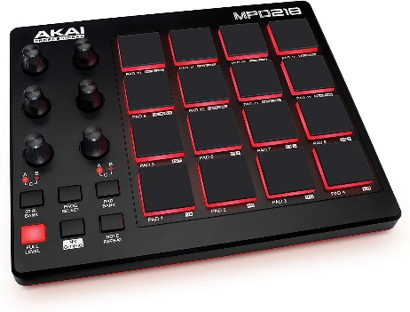
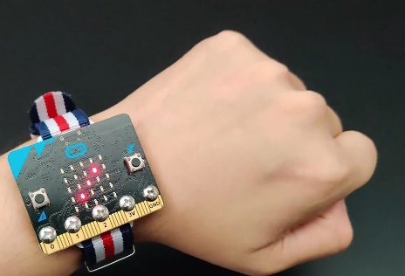
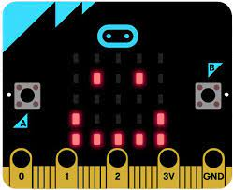
Final projects
Opportunity for you to apply your interests to this course
In groups of 1-2 students
Demonstrate course knowledge through any application
Limited by the parts in the kit, unless you have other things on hand
Some ideas (just with kit parts)
Video game with motion controls
Music pad controller
Morse code decoder
Smartwatch
Tamagotchi

Slide 36
Deadlines
Labs are due a week from release date
Require checkoffs from course staff during Lab or Office Hours
Quizzes will also have a due date
And a limited time window for completion once started
Late penalty: 10% deduction from max score per day

Slide 37
Flexibility
Sometimes stuff just doesn’t work
Especially when we’re working with hardware
We can be flexible about those deadlines
If you’re having problems and tell us
Less flexible if you don’t communicate or if you started late
Takeaway: let us know if you’re having problems
Especially being remote, it’s hard for us to spot this
Notes:
Bonus note

Slide 38
Outline
Who and Why
Embedded Systems
Course Overview

Slide 39
Outline
Bonus: embedded systems research

Slide 40
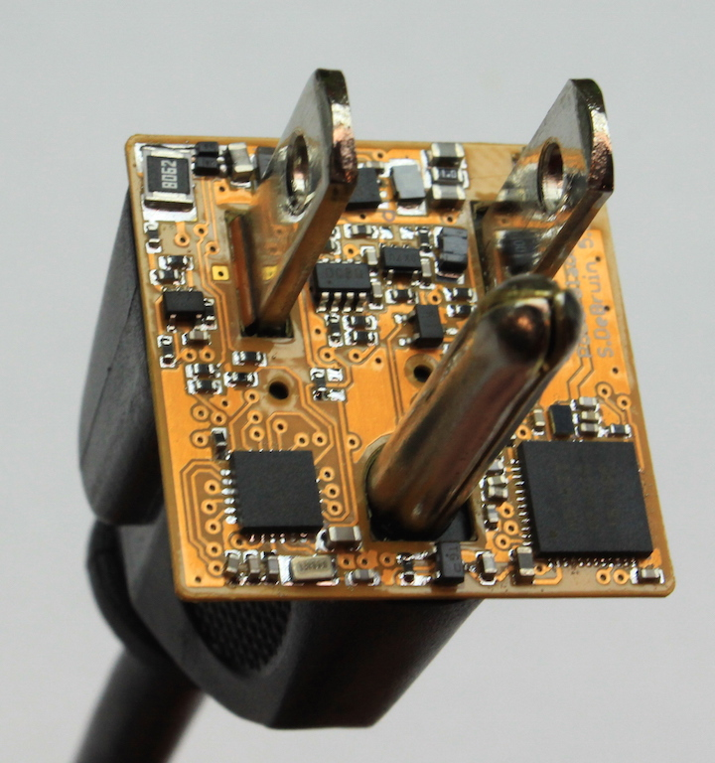
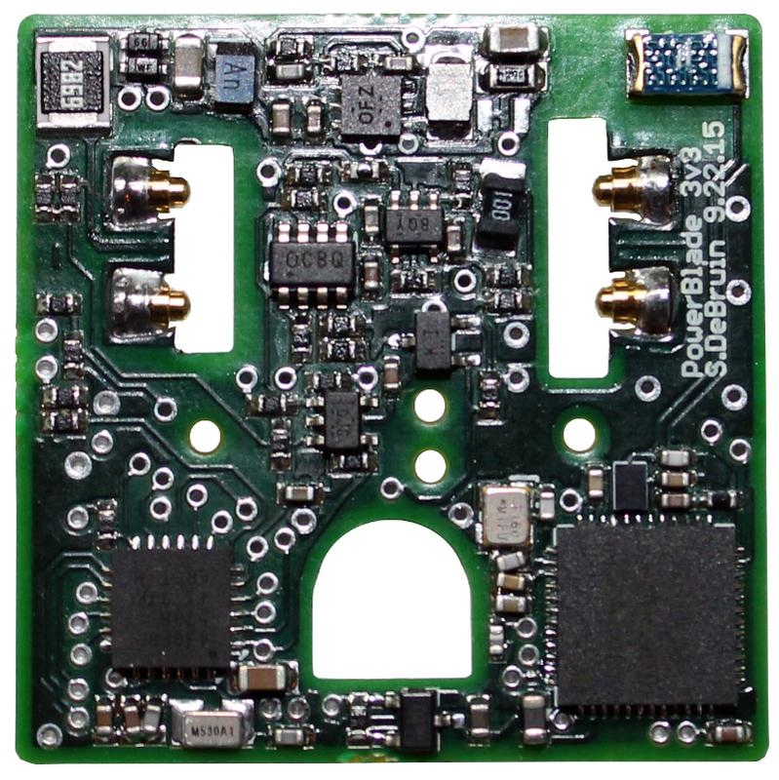
PowerBlade – Smart Home
Plug-load power meter
How do we measure every device in a home?
Challenges
Deployability
Powering it
Sensing AC current and voltage
Reporting measurements
https://www.youtube.com/watch?v=oNUXhCDnHoE

Slide 41
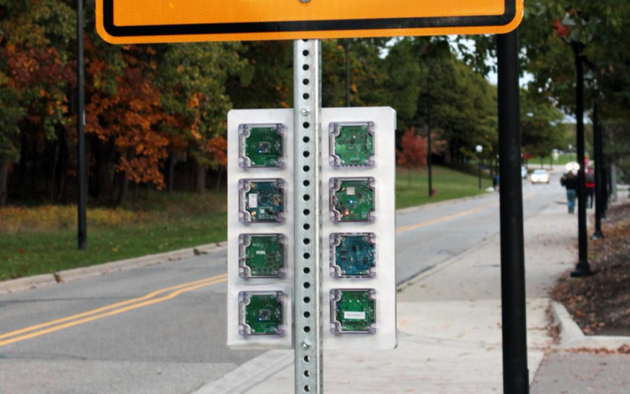
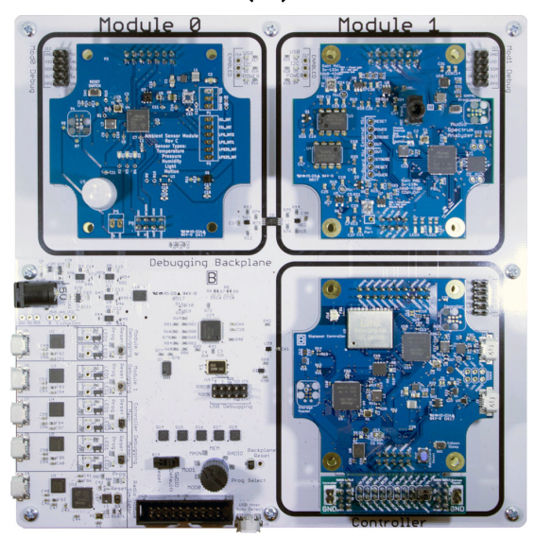
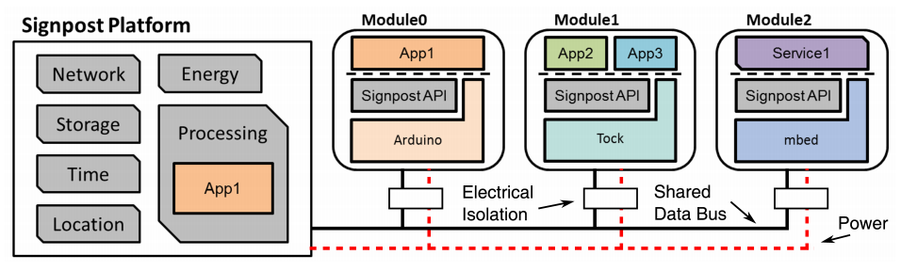
Signpost – City-Scale Sensing
How do we reduce the burden of city-scale sensing experimentation?
Platform provides resources
Modules provide sensor and application

Slide 42


Tock – Reliable, security-conscious embedded OS in Rust
C App Ported to Tock
App written in Rust
[Service] BLE Environmental Sensing Profile
while(1)
😈
Untrusted
(isolated by the MPU and preemptively scheduled)
Syscall Interface
libtock
libtock-rs
libtock
libnrf
Kernel (Rust)
System Calls
Thread
Virt. Timer
BLE
Temp. Sensor
Untrusted
(unsafe forbidden)
Capsules
6LoWPAN
SD Card
Console
SI7021
Core Kernel
Scheduler, Process management, etc.
Standardized Hardware Interface Layer (HIL)
Trusted
(unsafe allowed for MMIO, PIC, etc.)
Microcontroller-specific Peripheral Drivers
SPI
RNG
Timer
ADC
GPIO
I2C
UART
AES
DAC
USB
Hardware
CPU
SPI
RNG
Timer
ADC
GPIO
I2C
UART
AES
DAC
USB

